Slide 1
Measuring Real-World Accuracies and Biases in Modeling Password Guessability
Segreti. et al.
Usenix Security 2015

Slide 2
What is password guessability?
It measures how easy to guess a password.
Bad password: “password”, “Iloveyou”
Good password: “qw3^D)Z1”, “j@mesb0nd007!”
Different ways:
Traditional:
Shannon Entropy (not practical)
NIST Entropy (rule based)
Currently:
α-guesswork
Parameterized metrics

Slide 3
Why measures password guessability?
Eliminate bad passwords.
Organizational password audits
2. Help users create better passwords.
Provide feedback

Slide 4
Password Guessability Metrics
Statistical metrics
α-guesswork
it takes 1 million guesses for an attacker to guess 10% of passwords in a password set
measures password set as a whole
Parameterized metrics
Investigate guessability under a cracking algorithm (simulate an attacker)
measures guessability of individual password.
security against real-world attacks, not idealized attacks.
Does it accurately model real-world attackers?
Does the attacker run only one algorithm?
Parameter tuning.

Slide 5
Cracking Algorithm
Brute-force and mask Attacks
Dumbly iterate all possibilities
Mask attacks first give a mask and then iterate
e.g. choose L6D1
start from aaaaaa0, aaaaaa1, aaaaaa2, etc
Mangled wordlists attacks (may be the most popular)
given a dictionary that contains possible passwords
mangling rules
e.g. ‘password’ -> ‘p@ssword’

Slide 6
Cracking Algorithm
Probabilistic context-free grammar (PCFG)
Train using real-world passwords (usually from breached password set)
Build a password distribution model
ranks password structure by probability
e.g. p(L3D3S1) = 0.05%
ranks special characters and numbers by probability
e.g. p(123|D3) = 0.04%, e.g. p(!|S1) = 20%
insert characters using an external library
e.g. has 50 L3 entries. p(L3) = 1/50
Generate password guess by descending probability:
e.g. p(“abc123!”) = 0.05% * 0.04% * 20% * 1/50

Slide 7
Cracking Algorithm
Markov Models
Train using real-world passwords (usually from breached password set)
Choose an order, build markov models and compute probability of guesses.
e.g order-5 markov model, what is the probability of “abcde”?
p(abcd) = 10%
p(e|abcd) = 80%
p(bcde|end) = 30%
p(“abcde”) = 10% * 80% * 30%
try guesses in descending probability order

Slide 8
This paper will...
Analyze 4 automated cracking algorithm and 1 manual cracking method.
Show that a single cracking algorithm relatively out-of-box produces a poor estimate of password guessability.
Uncover the export procedure - using multiple well-configured algorithm in parallel.

Slide 9
This paper
What to expect from this paper:
Measurement, comparison of existing password cracking algorithm.
comparison of algorithm efficiencies between researcher and attacker.
What not to expect from this paper
Novel technique or algorithm
New system

Slide 10
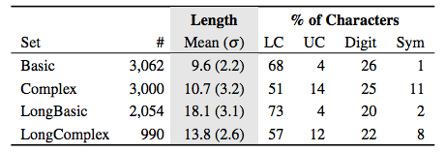
Dataset (testing data)
13,345 passwords created under composition policies.
Amazon Mechanical Turk
Basic: 8+ chars
Complex: 8+ chars, containing 4 character classes
LongBasic: 16+ chars,
LongComplex: 16+ chars, containing 4 character classes
15,000 from rockyou leak and 15,000 from Yahoo leak

Slide 11
Dataset (Training data)
Breaches of MySpace, Rockyou, and Yahoo
Dictionaries (19.4m in total):
Single words from Google Web Corpus
UNIX dictionary
250,000 words inflection dictionary

Slide 12
Simulating Password Cracking
PCFG
Markov-Model
John the Ripper
Hashcat
Professional Cracker (Done by a security company - KoreLogic)

Slide 13
KoreLogic - professional cracker
Use JTR and Hashcat with proprietary wordlists, mangling rules, mask lists, and Markov models
Optimized over 10 years of password auditing
Dynamically update their mangling rules
Attack
Complex
Long
Long Complex

Slide 14
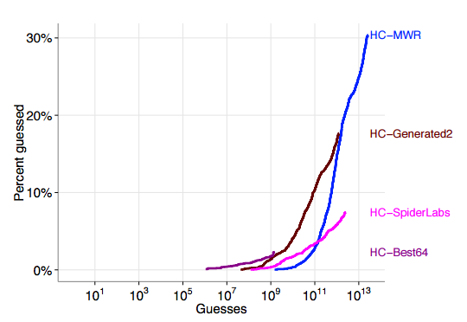
Results - Configuration
out-of-the-box configurations commonly used by researchers substantially underestimate password vulnerability.
Hashcat different configuration
PCFG and Markov Model
Training Data
Conclusion:
Unoptimized configuration means
underestimation the vulnerabilities

Slide 15
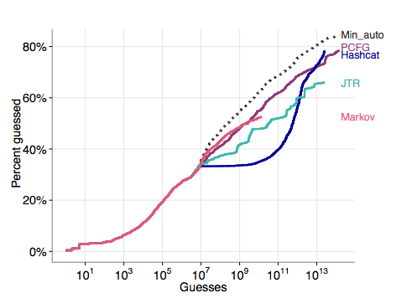
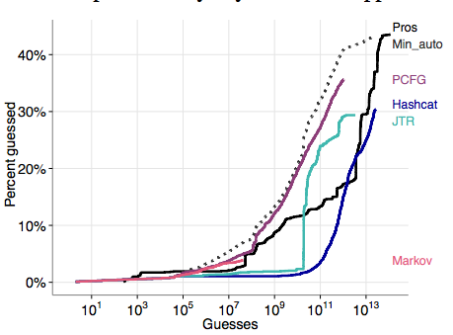
Guessing by automated approaches
Attack Baisc Passwords Attack Long Passwords

Slide 16
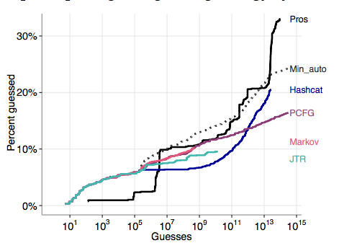
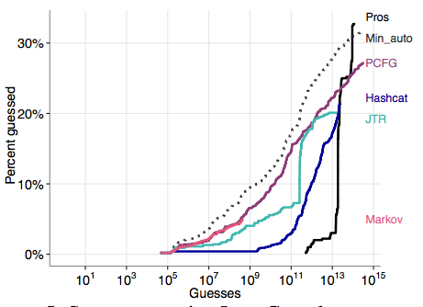
Guessing by automated approaches
Attack LongBasic Passwords Attack LongComplex Passwords

Slide 17
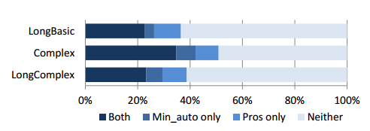
Guessed portion of password
Limite: 10^(14) guesses

Slide 18
Guessing by pros
Automated Approaches guess more in early stage
An analyst wrote free-style rules at 10^(13) guesses, which significantly increase the cracked passwords
Min_auto metric is a conservative approximation of the success of Pros

Slide 19
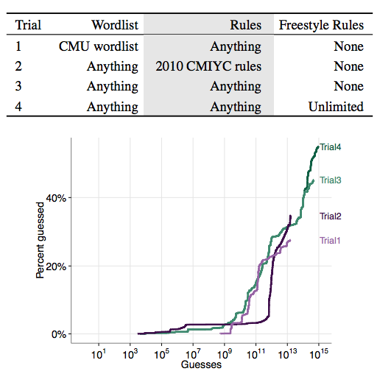
Limited Professional Cracking
Attack 4239 complex passwords

Slide 20
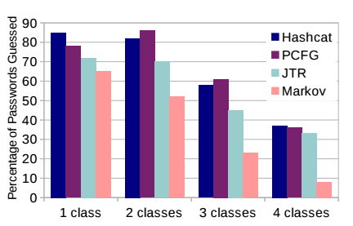
Difference between approaches - Coverage
Basic Password
On contrast:
LongBasic Shared: 6%
28% of Complex, LongBasic, and LongComplex passwords were guessed only by a single approach.

Slide 21
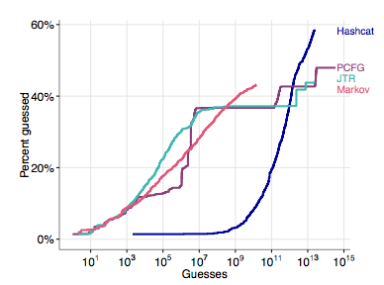
Difference between approaches - Char types
Passwords contain only
lower-case characters
Also different in other settings

Slide 22
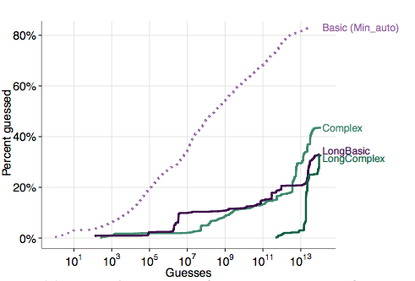
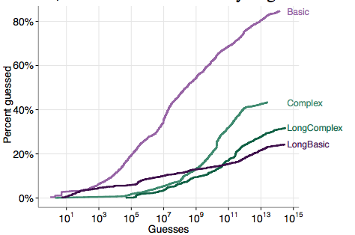
Difference between approaches - Different Policies
Pro Attack Automated Attack
(all attacking algorithms)

Slide 23
Difference between approaches - Different Policies

Slide 24
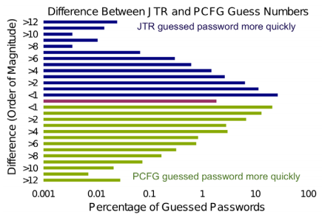
Difference between approaches - Individual Password

Slide 25
Conclusion
A single guessing algorithm -> poor estimation
several well-configured algorithms -> fairly good estimation of real attackers
Different approaches have different outcome

Slide 26
Questions
why do we measure password strength? (2 main reasons)
2. Why is measuring password strength difficult?
3. What should a researcher do to make his estimation of password strength more accurate?

Slide 27
Questions
why do we measure password strength? (2 main reasons)
Why is measuring password strength difficult?
What should a researcher do to make his estimation of password strength more accurate?

